Slide 1


Slide 2
Agenda
Problem Statement 03
Data Mining - 01 04
Data Mining - 02 05
Exploratory Data Analysis (EDA) 06
Data Visualization 07
Algorithms Used 08
Analysis of Results 09
Conclusion & Future Work 10

Slide 3
Problem Statement
The objective of this develop a predictive model that can determine the presence or absence of smoking in individuals based on their bio signals the target variable indicates whether the individual is a smoker (1) or a non smoker (0).
The model should take into account various factors such as gender category, age , cholesterol, blood sugar, hemoglobin, and other relevant features available in the dataset.
In this project, we aim to develop a machine learning model that can accurately classify individuals as smokes or non smokers using their bio-signals and evaluated on the provided dataset using appropriate evaluation metrices to assess its performance.

Slide 4
Data Mining-01
55692
Firstly the data set contains Different data types
Float(64) Data Type – 18
Int64 Data Type - 6
Object Data Type – 3
The shape of the Data Set is 319795, 27(Rows , Columns)
There are no Duplicate values in the dataset so, we don’t need to delete any duplicate values
If Duplicates occur then after deleting the duplicate values reset the row index.
The Ratio proportion of the dataset is balanced with 1.72 :1 , hence there is no need to over sampling and under sampling techniques

Slide 5
Data Mining- 02
By using Label Encoding and mapping method converting the object data type into int datatype
In the "Age Category" column, which represents age ranges, we will perform a transformation by replacing each range with the corresponding mean age value.
The dataset doesn’t have any null values Hence we can proceed for the next step
We have to delete ID variable in the dataset because the variable is not influencing target variable(Smoking)

Slide 6
Exploratory Data Analysis (EDA)
In the dataset the target variable is “Smoking” because our machine learning model is to predict the person who is Smoking or not
And all other are independent variables because all are influencing the target variables.
After identifying the target variable we can split the data set into train and test data by using sklearn train_test_split() method
After dividing the dataset into train and test, train data is used to train the model algorithms and test data is used to test the accuracy of the model algorithms

Slide 7
Algorithms Used
Our problem is classification problem.
There are total seven algorithms in classification problems
Logistic Regression
Decision Tree Classification
Random Forest
Extra Trees Classification
KNN Algorithm
SVM Algorithm
Naïve Bayes Algorithm
Among 7 algorithms, in KNN algorithm there is a need to find the highest accuracy n value
And also there are 4 types of models are there in SVM Algorithm

Slide 8
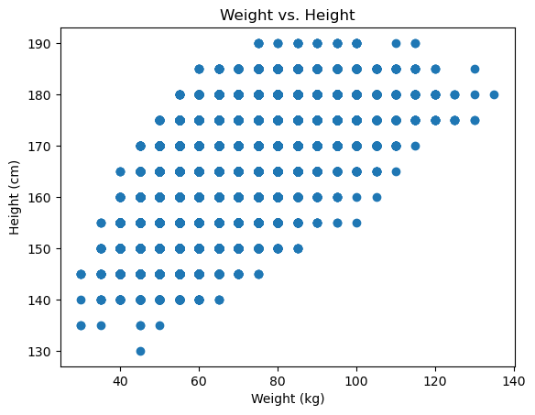
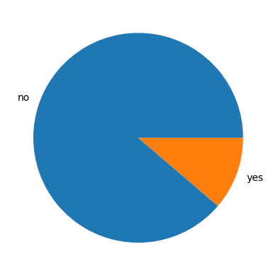
Data Visualization

Slide 9
Analysis of Results
From KNN Algorithm k=01 gives the best accuracy,
From SVM Algorithms SVM – Polynomial gives the best accuracy.
Hence KNN at k=01 and SVM – Polynomial selects and comparing with other algorithms.

Slide 10
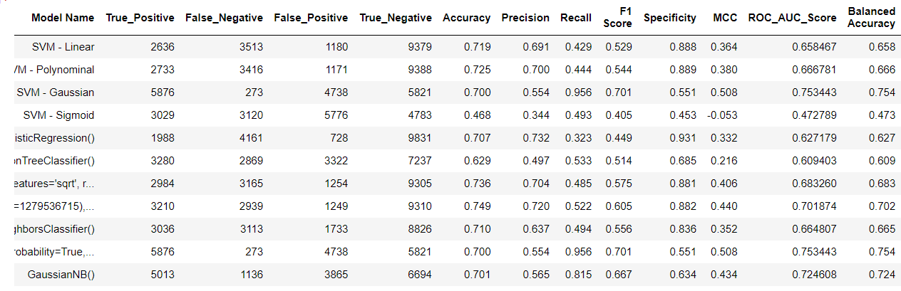
Conclusion and Future Work
After evaluating various algorithms, we have found that K-Nearest Neighbors (KNN) achieves the highest accuracy among them
Therefore, we will utilize the KNN algorithm to predict the presence of Smokers in our model

Slide 11
Thank You
Q & A
Student Name : Oleti Satish Varma
Roll Number : 21B91A5743
SRKR Engineering College
Mobile: +91 8247003162
Email: 21B91A5743@srkrec.ac.in
Bhimavaram - India

